Slide 1
Object Oriented Programming—C++ Lecture6 Classes
Qijun Zhao
College of Computer Science
Sichuan University
Spring 2023

Slide 2
This lecture combines reading materials: Pages 193-232 of the textbook.
(Chapter 8: Abstraction and Classes)

Slide 3
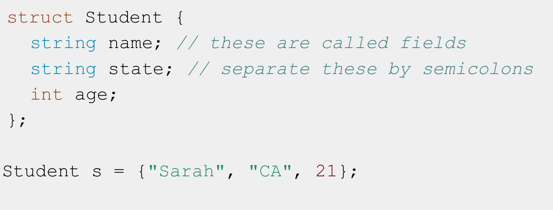
Definition
Class: A programmer-defined custom type. An abstraction of an object or data type.
But don’t structs do that?

Slide 4
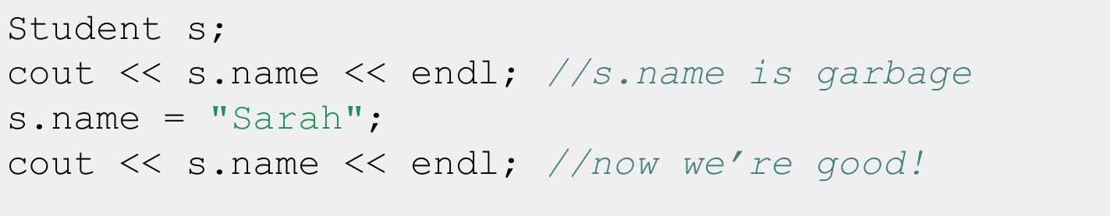
Issues with structs
- Public access to all internal state data by default
- Users of struct need to explicitly initialize each data member.

Slide 5
“A struct simply feels like an open pile of bits with very little in the way of encapsulation or functionality. A class feels like a living and responsible member of society with intelligent services, a strong encapsulation barrier, and a well defined interface.”
- Bjarne Stroustrup

Slide 6
Classes provide their users with a public interface and separate this from a private implementation

Slide 7
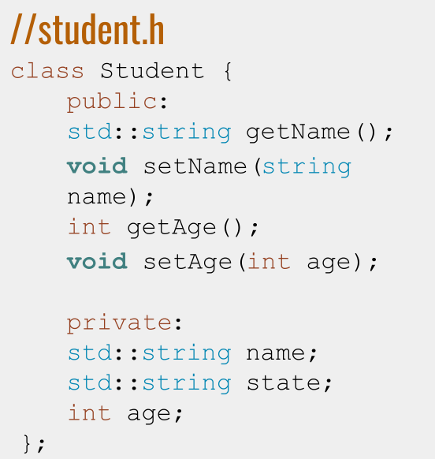
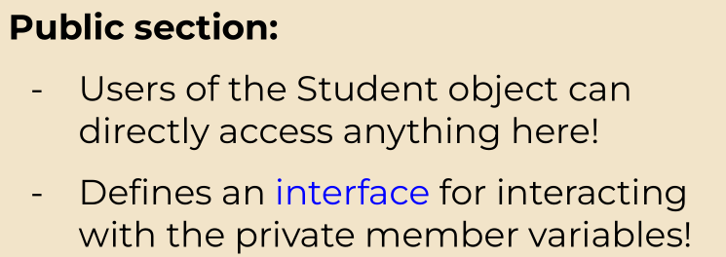
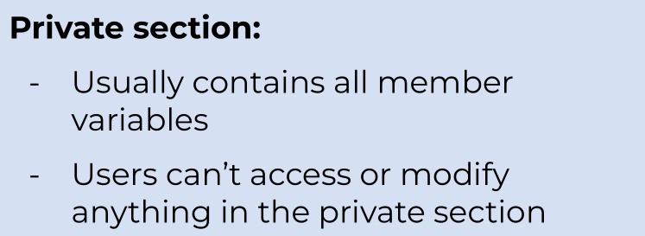
Turning Student into a class: Header File

Slide 8
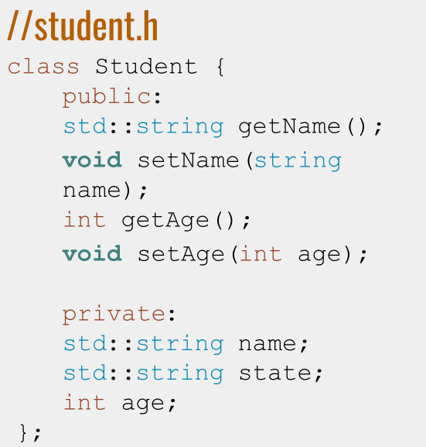
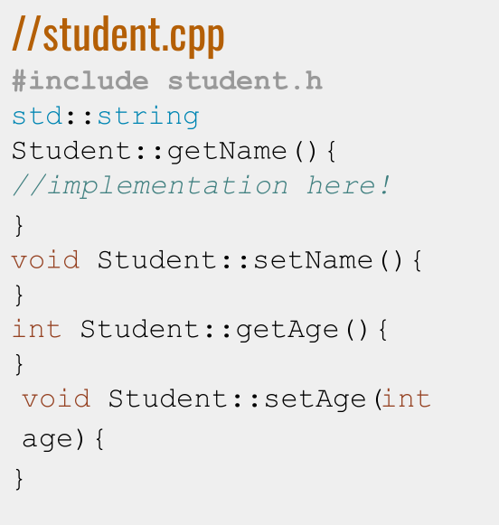
Turning Student into a class: Header File + .cpp File

Slide 9
Recall: namespaces
- Put code into logical groups, to avoid name clashes
- Each class has its own namespace
- Syntax for calling/using something in a namespace:

Slide 10
Function definitions with namespaces!
- namespace_name::name in a function prototype means “this is the implementation for an interface function in namespace_name”
- Inside the {...} the private member variables for namespace_name will be in scope!

Slide 11
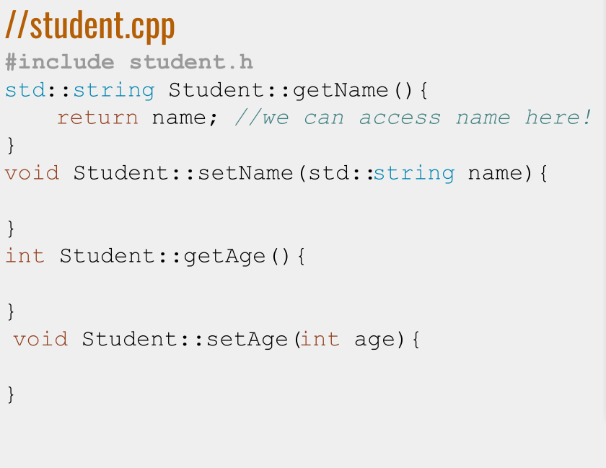
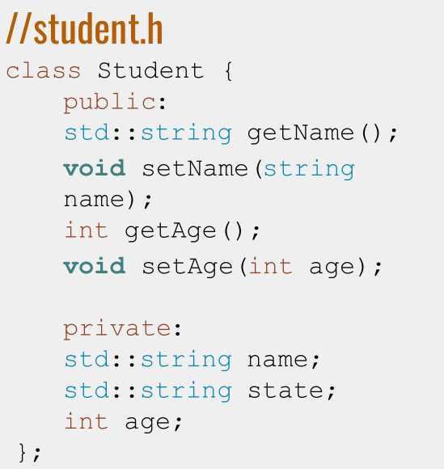

Slide 12
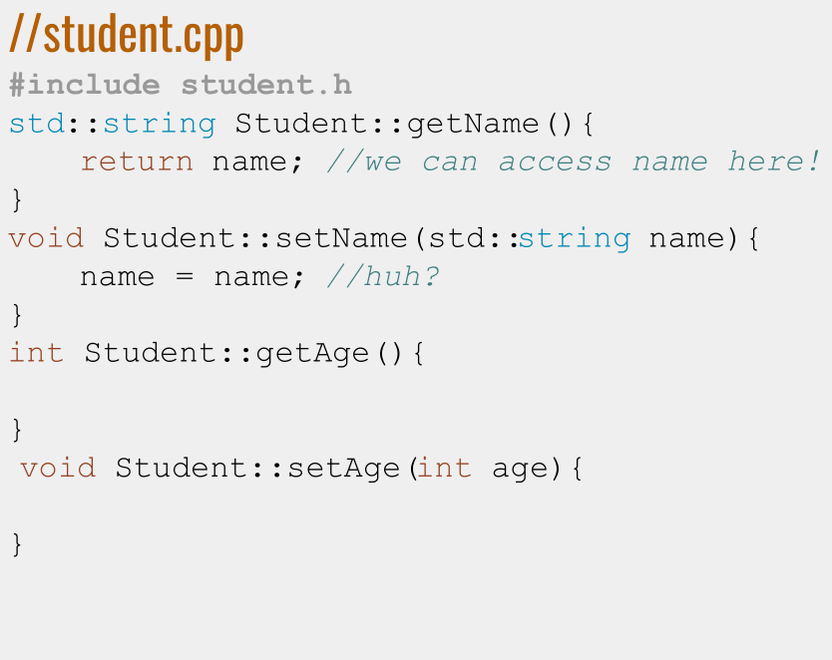
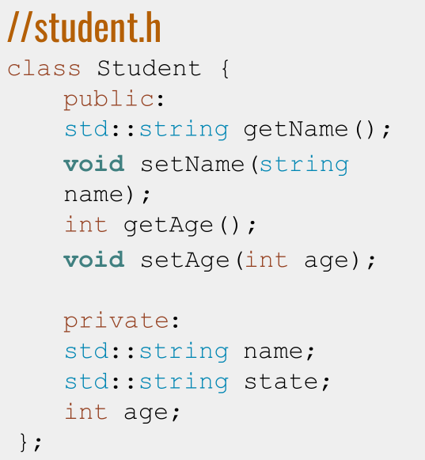

Slide 13
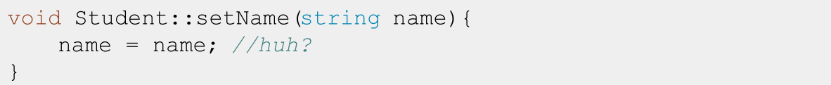

The this keyword!
- Here, we mean “set the Student private member variable name equal to the parameter
- this->element_name means “the item in this Student object with name element_name”.
Use this for naming conflicts!

Slide 14
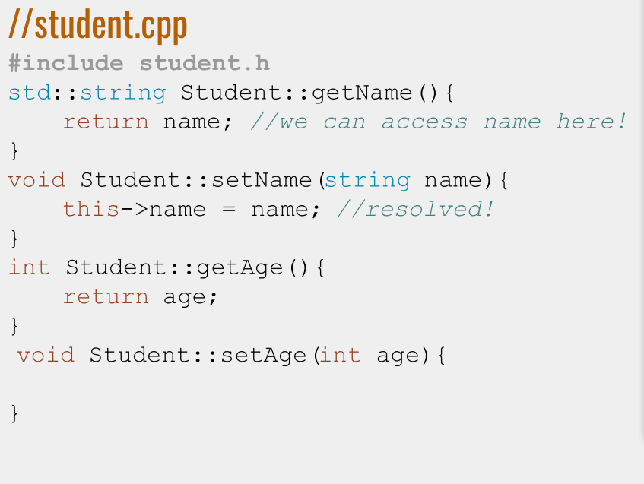
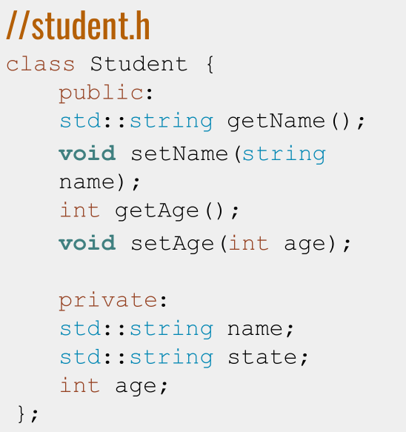

Slide 15
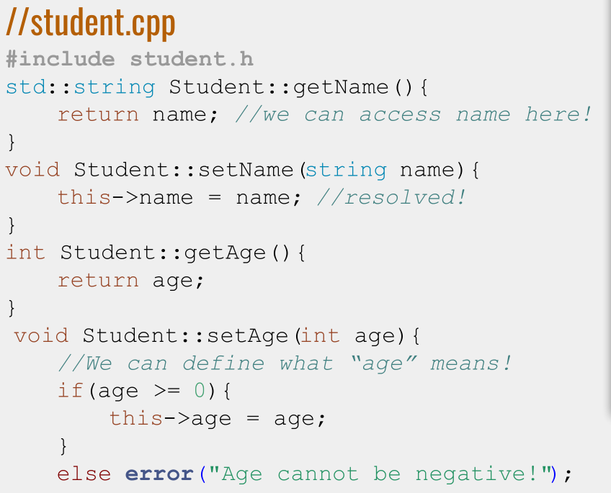
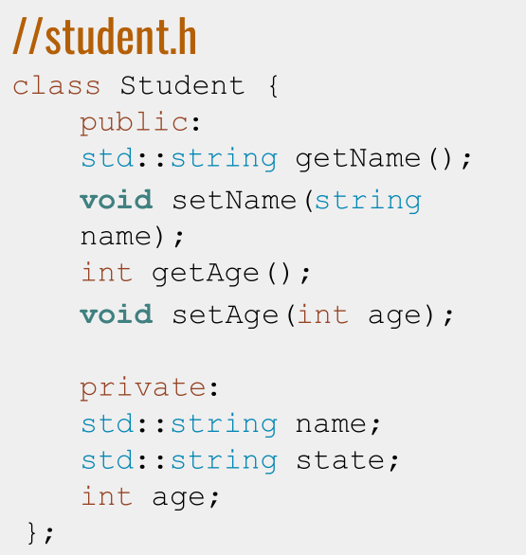

Slide 16
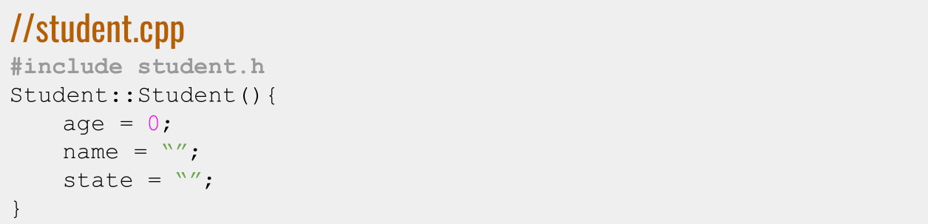
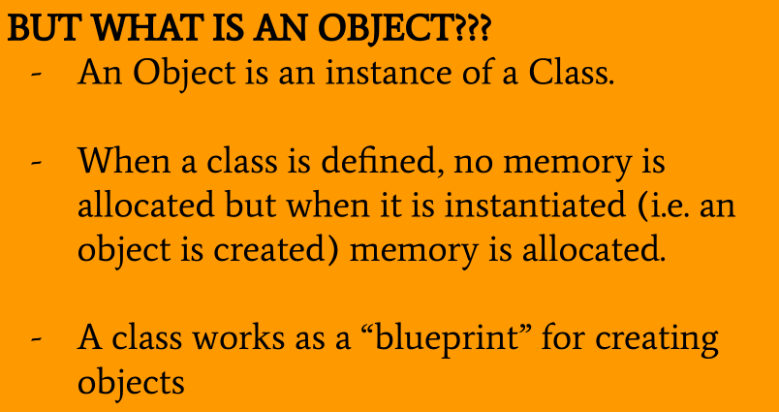
Constructors 1.0
- Define how the member variables of an object is initialized
- What gets called when you first create a Student object

Slide 17
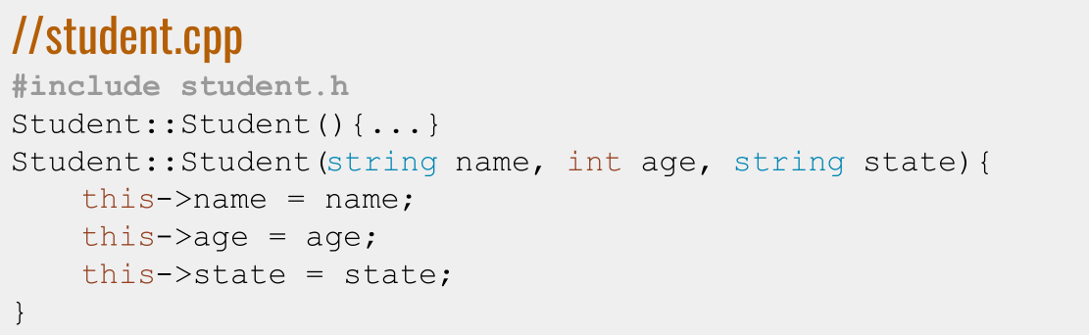
Constructors 2.0
- Overloadable!

Slide 18

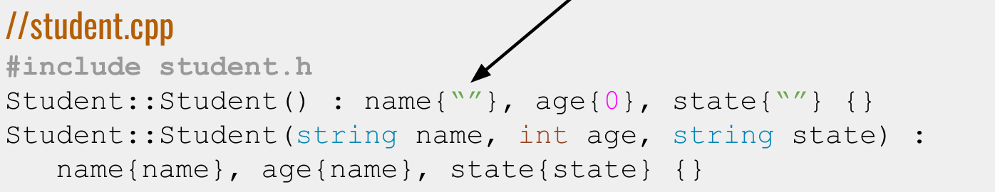
Constructors 3.0
- Use initializer lists for speedier construction!

Slide 19
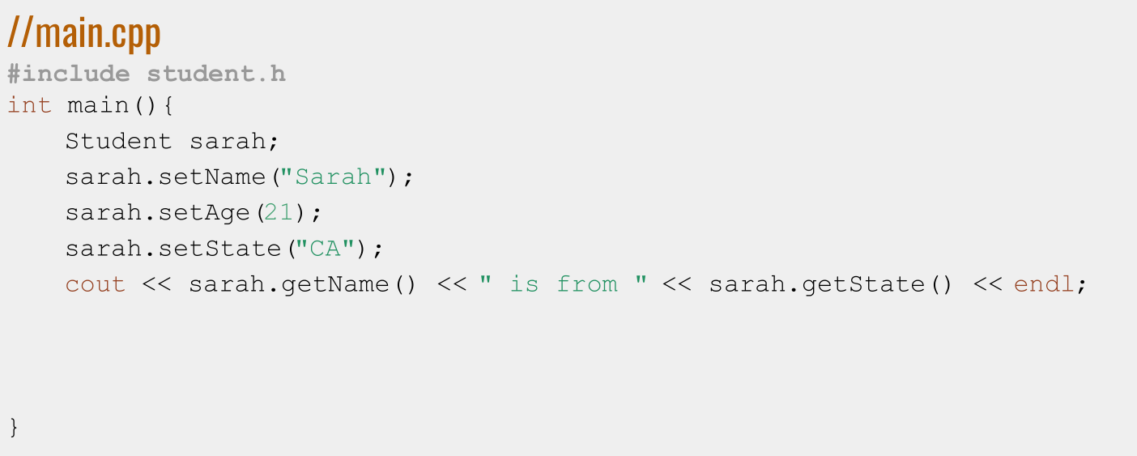
Putting it all together: Using your shiny new class!

Slide 20
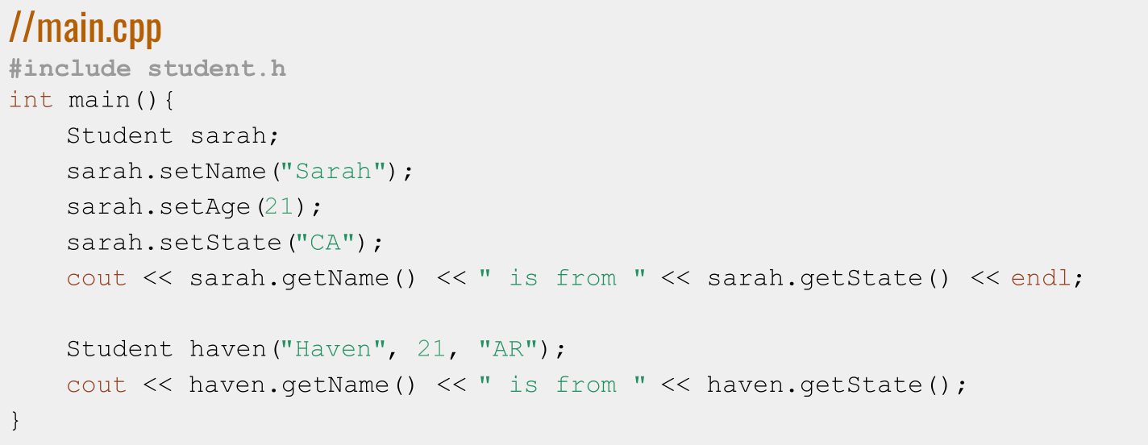
Putting it all together: Using your shiny new class!

Slide 21
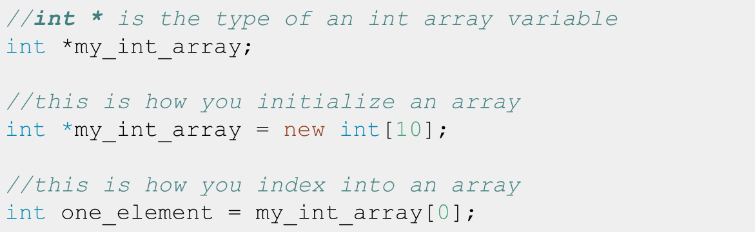
Aside… Arrays
- Arrays are a primitive type! They are the building blocks of all containers
- Think of them as lists of objects of fixed size that you can index into
- Think of them as the struct version of vectors. You should not be using them in application code! Vectors are the STL interface for arrays!

Slide 22
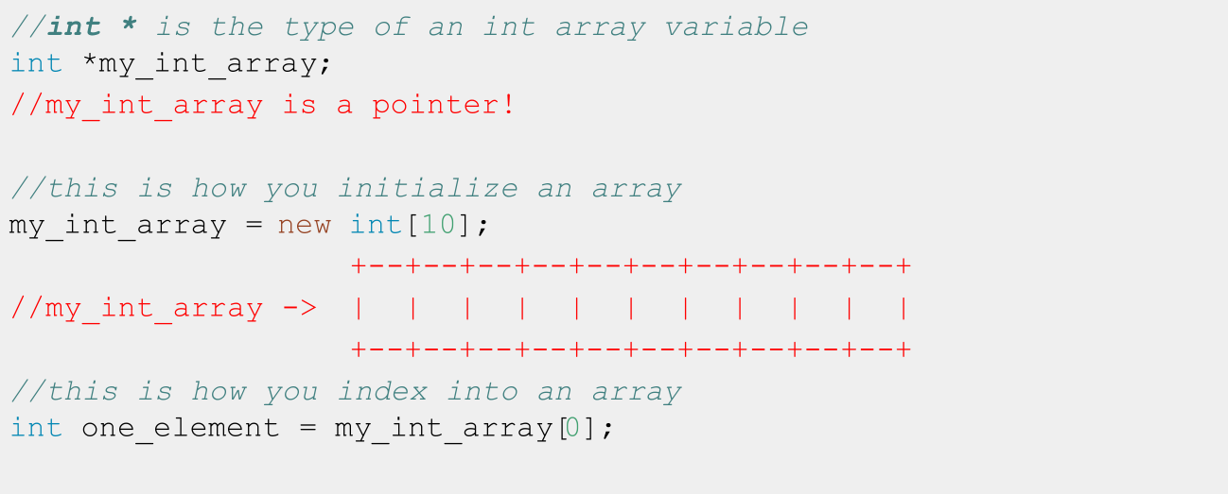
Recall: Arrays

Slide 23
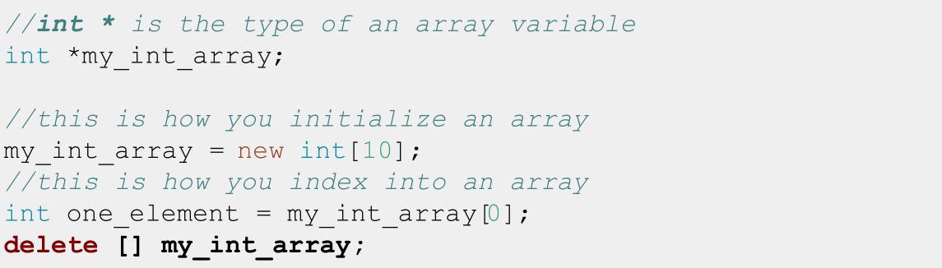
Memory Management
- Arrays are memory WE allocate, so we need to give
instructions for when to deallocate that memory!
- When we are done using our array, we need to delete [] it!

Slide 24
Destructors
- deleteing (almost) always happens in the destructor of a class!
- The destructor is defined using Class_name::~Class_name()
- No one ever explicitly calls it! Its called when Class_name object go out of scope!
- Just like all member functions, declare it in the .h and implement in the .cpp!

Slide 25
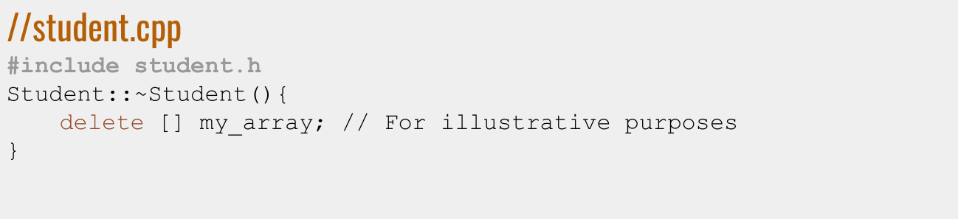
Destructor
- Free your memory!

Slide 26
Definition
Fundamental Theorem of Software Engineering: Any problem can be solved by adding enough layers of indirection.

Slide 27
The problem with StrVector
- Vectors should be able to contain any data type!
- What if we want to make a vector of Students?
- How are we supposed to know about every custom class?
- What if we don’t want to write a class for every type we can think of?

Slide 28
Definition
Template Class: A class that is parametrized over some number of types. A class that is comprised of member variables of a general type/types.

Slide 29
Template Classes You’ve Used
- Vectors!
- Maps!
- Sets!

Slide 30
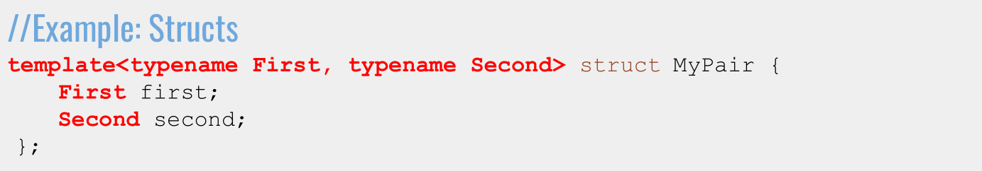
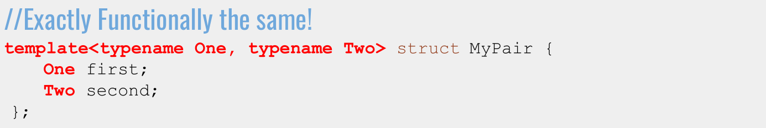
Writing a template: Syntax

Slide 31
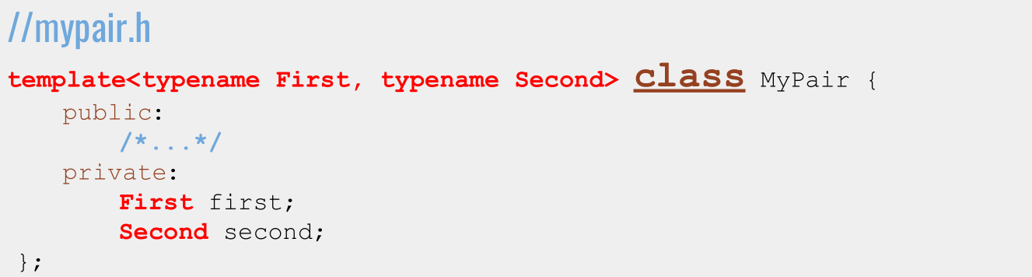
Writing a Template Class: Syntax

Slide 32
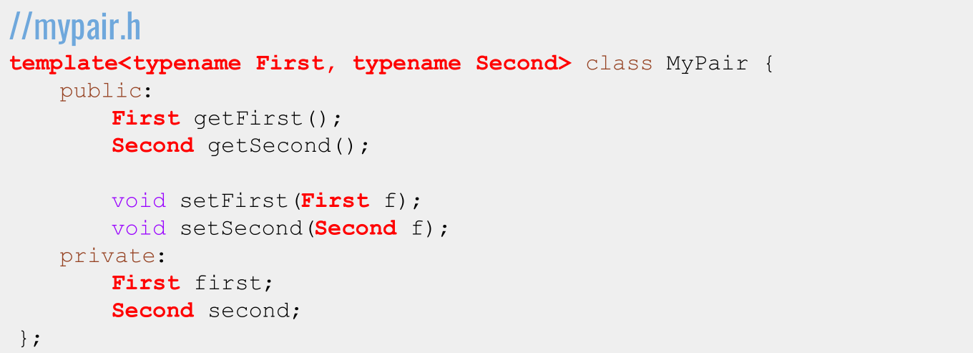
Writing a Template Class: Syntax

Slide 33
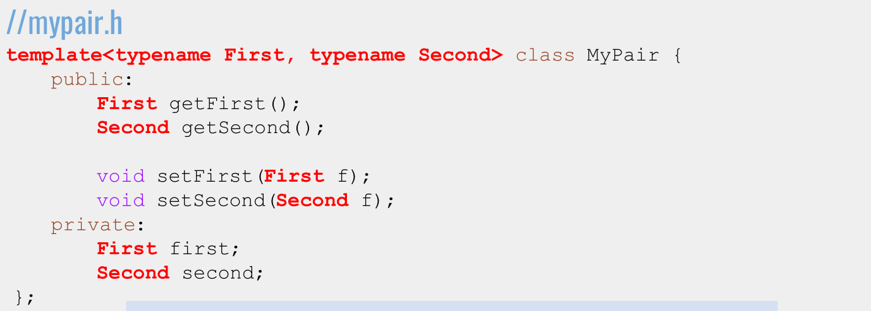

Writing a Template Class: Syntax

Slide 34
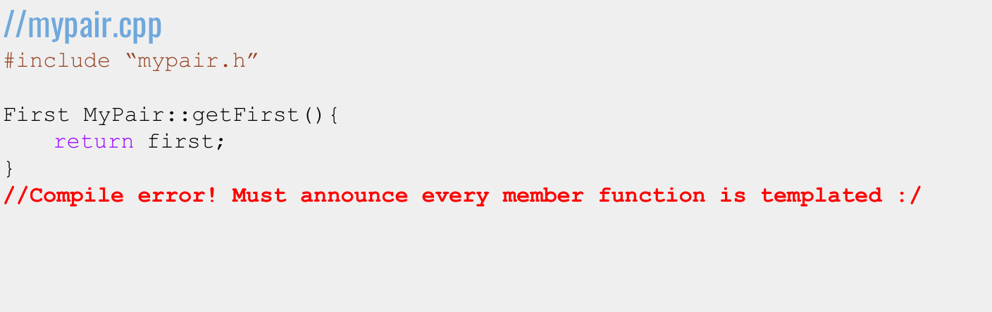
Implementing a Template Class: Syntax

Slide 35
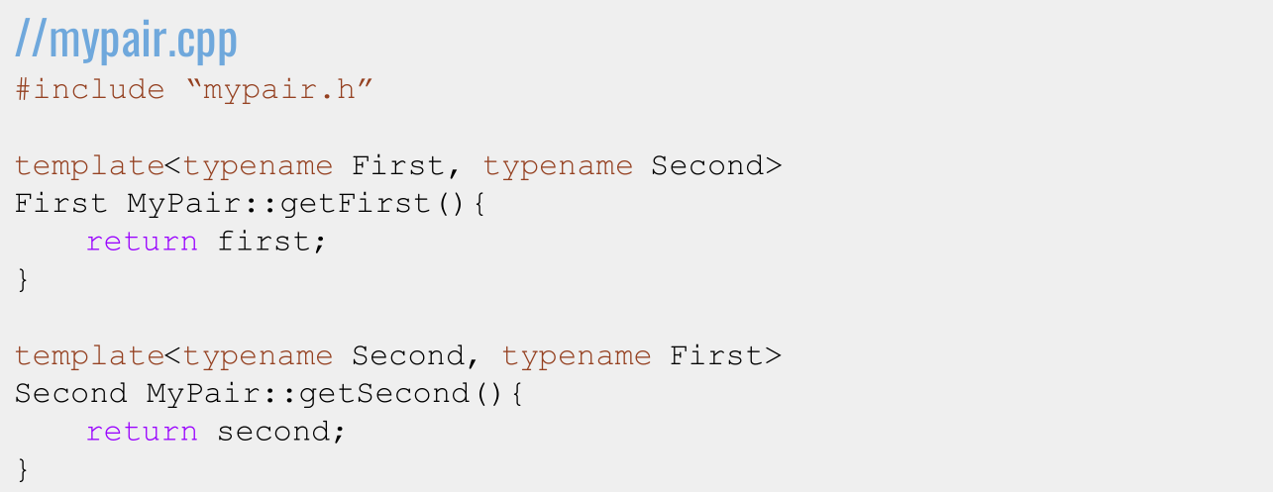
Implementing a Template Class: Syntax

Slide 36
A sneaky bug
The Takeaway
Templates don’t emit code until instantiated, so include the .cpp in the .h instead of the other way around!

Slide 37
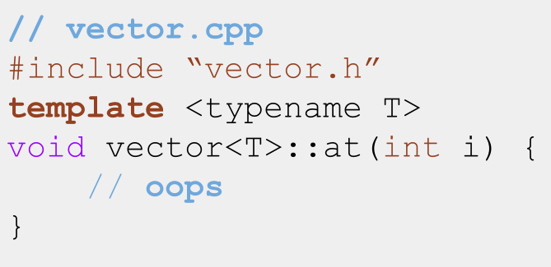
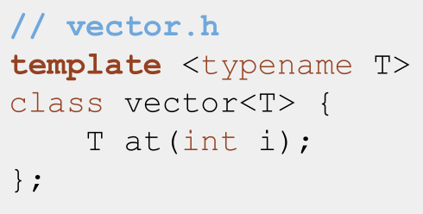
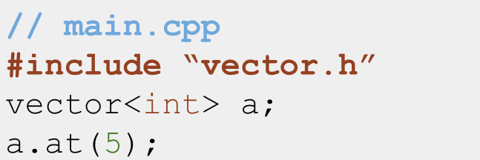
A compile error....

Slide 38
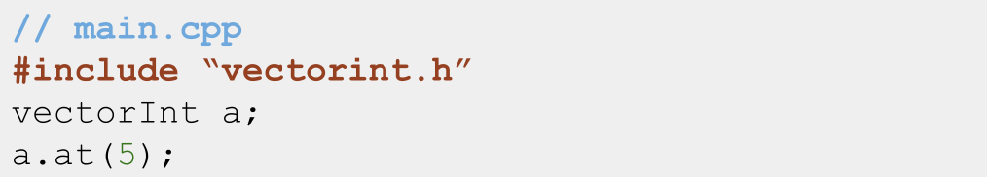
What the C++ compiler does with non-template classes
1. g++ -c vectorint.cpp main.cpp: Compile and create all the code in vectorint.cpp and main.cpp. All the functions in vectorint.h have implementations that have been compiled now, and main can access them because it included vectorint.h
2. “Oh look she used vectorInt::at, sure glad I compiled all that code and can access vectorInt::at right now!”

Slide 39
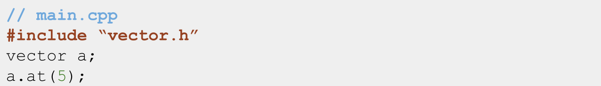
What the C++ compiler does with template classes
1. g++ -c vector.cpp main.cpp: Compile and create all the code in
main.cpp. Compile vector.cpp, but since it’s a template, don’t create any code yet.
2. “Oh look she made a vector<int>! Better go generate all the code for one of those!”
3. “Oh no! All I have access to is vector.h! There’s no implementation for the interface in that file! And I can’t go looking for vector<int>.cpp!”

Slide 40
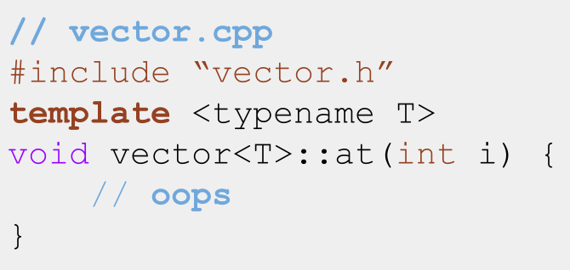
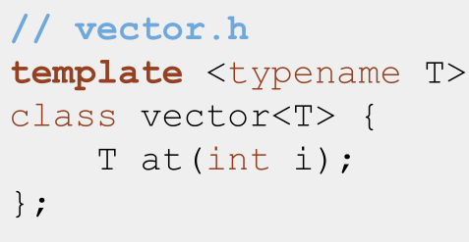
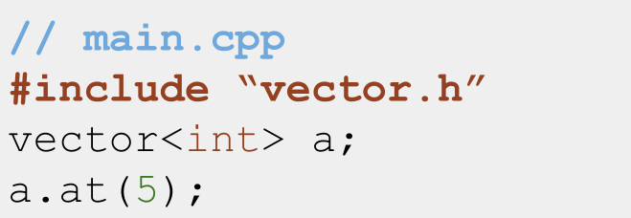
The fix...

Slide 41
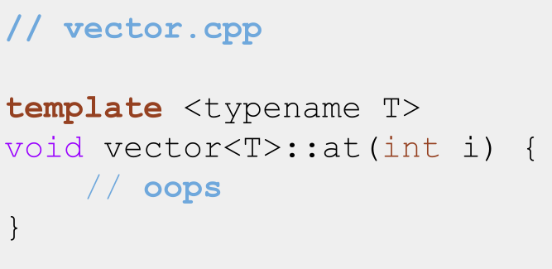
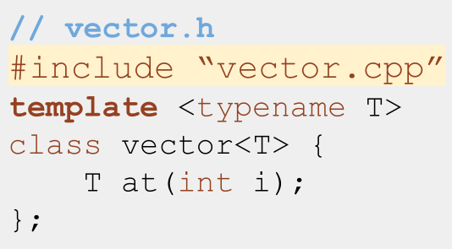
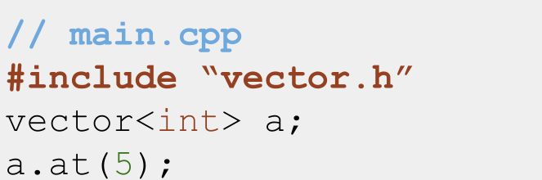
Include vector.cpp in vector.h!

Slide 42
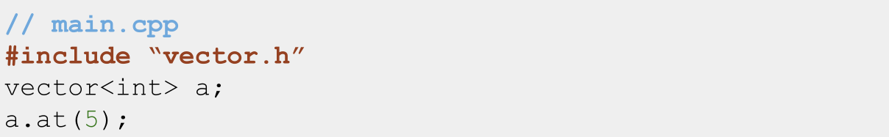
What the C++ compiler does with template classes
1. “Oh look she included vector.h! That’s a template, I’ll wait to link the implementation until she instantiates a specific kind of vector”
2. “Oh look she made a vector<int>! Better go generate all the code for one of those!”
3. “vector.h includes all the code in vector.cpp, which tells me how to create a vector<int>::at function :)”

Slide 43
The Takeaway
Templates don’t emit code until instantiated, so include the .cpp in the .h instead of the other way around!

Slide 44
Coding for love, Coding for the world
Qijun Zhao
qjzhao@scu.edu.cn

